Slide 1
Chapter 8
Unified Theory of Electrical machine
Electrical Machines And Their Drives

Slide 2
Content
8.1 Basic Concept of Unified Theory and Electrical Circuit Basis
8.2 DC Machine
8.3 Induction Machine

Slide 3
8.1 Basic Concept and
Electrical Circuit Basis
8.1.1 Basic Concept of Unified Theory
8.1.2 Two Coil model
8.1.3 Basic Concept of Moving Coils
8.1.4 Voltage Equations with Coil Moving

Slide 4
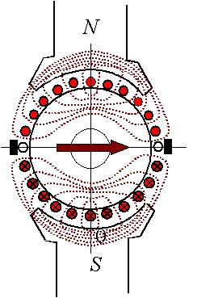
8.1 Basic Concept of Unified Theory and Electrical Circuit Basis
8.1.1 Basic Concept of
Unified Theory
or
“Primitive” Machine
in d-q axes
1. Magnetic Field in DC Machine
Fig8.1 DC Machine

Slide 5
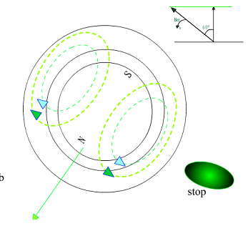
2. Magnetic Field in Induction Machine
Stator MMF speed
Rotor speed
Rotor MMF speed
Fig8.2 Induction Machine

Slide 6
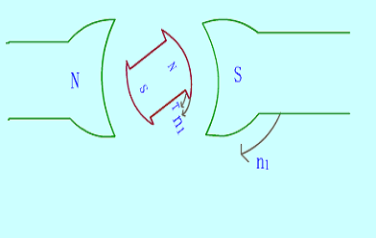
3. Magnetic Field in Synchronous Machine
Stator MMF speed
Rotor speed
Fig8.3 Synchronous Machine

Slide 7
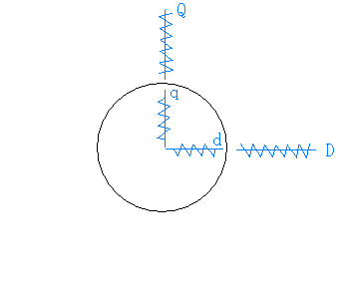
4. Basic Concept of Unified Theory
Stator winding D-Q
Rotor winding d-q
D, d --- Direct axes
Q, q --- Quadrature axes
Fig8.4 “Primitive” Machine

Slide 8
>>Solution:
1. With the previous knowledge of dc and ac machines, there are two magnetic fields in the machines and they keep at same “rotating” speed.
2. At steady-state, all spatial vectors and time phasors will be direct current quantities in d-q axes.

Slide 9
8.1.2 Two Coil Model
Assume two static Coils
Where: --winding resistors
--self inductance
--Mutual inductance

Slide 10
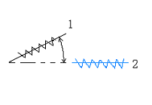

8.1.3 Basic Concept of Moving Coils
Mutual inductance M:
When
Fig8.6 Moving Coil

Slide 11
8.1.4 Voltage Equations with Coil Moving
_______ _________________ _______________________
Resistance Transformer Motional
Drop voltage voltage
No relative motion
With relative motion

Slide 12
8.2 Unified Theory to DC Machine
8.2.1 Applied to DC Machine
8.2.3 Torque Expression

Slide 13
8.2 Unified theory to DC Machine
8.2.1 Applied to DC Machine
Assume:
1-axis in line with q-axis ( )
Quadrature (Armature) axis
2-axis in line with d-axis ( )
Direct (Field) axis

Slide 14
Because M=0 ,then :
Also La is a constant,so:
then

Slide 15
Because M=0 , then :
Also field winding is standstill, so:
then
(8-6b)

Slide 16
Introduce an operator
Write (8-6a) and (8-6b) into matrix form:
(8-7)
or
(8-8)

Slide 17
If the voltages are known, and it is required to find the currents, the differential equations can be solved by algebraic manipulation using Laplace Transforms:
(8-9)
Where: --- the inverse of the impedance transform matrix
--- the transpose of
--- the transpose of

Slide 18
From (8-8), it can be written:
(8-10)
Now power in matrix form is written down as：
Mechanical energy
Copper Loss
Sroting inductive energy

Slide 19
8.3 Unified Theory to Induction Machine
8.3.1 Transformations from 3-phase to 2-phase
8.3.2 Transformations from Axes to
Axes
8.3.3 Voltage Balance Equations
8.3.4 Torque Expression

Slide 20
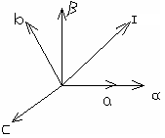

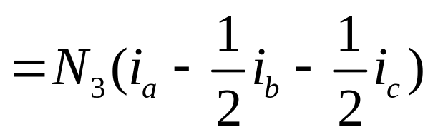
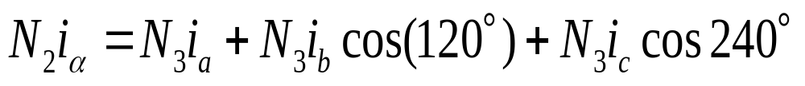
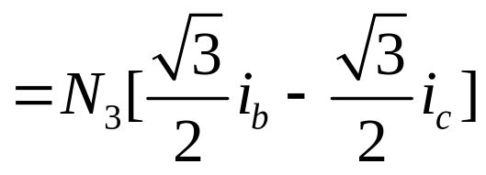
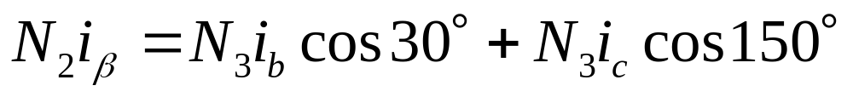
8.3.1 Transformations from 3-phase to 2-phase
1. Transformation Matrix
Select a-b-c and
axes as right diagram:

Slide 21


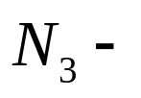
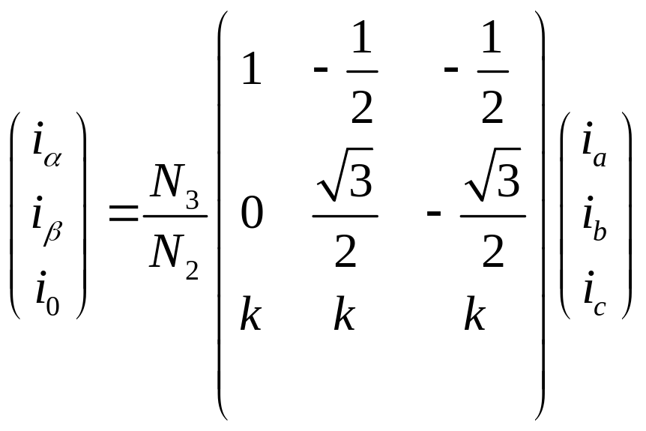

Where: is a zero vector just for the convenience of calculation.
Where:
Number of turns of axes
Number of turns of a-b-c axes.
Write (8.13) into matrix form:

Slide 22
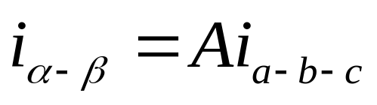
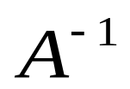
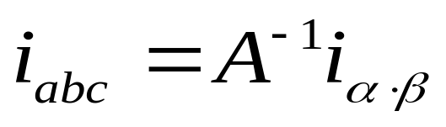
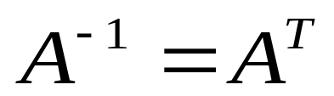
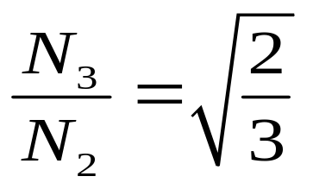
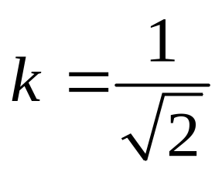
Or
If exists: then
Assume:
Then: and

Slide 23
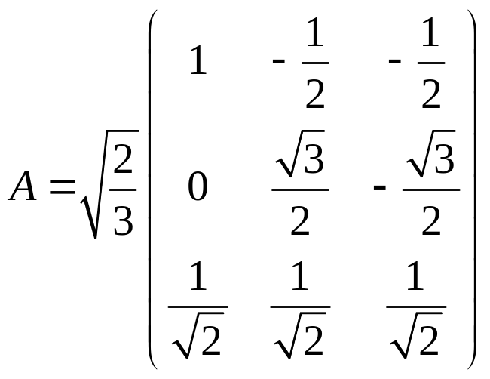
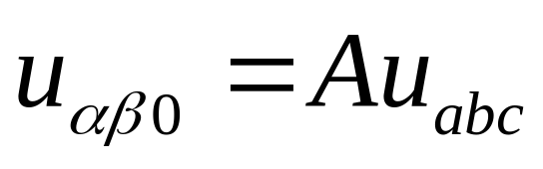
Then we can get voltage balance equation：
At both the stator side or rotor side, the A transformation matrix should be used to convert 3-phase system to
2-phase system.

Slide 24

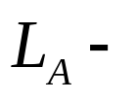
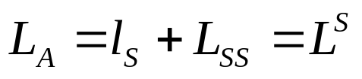
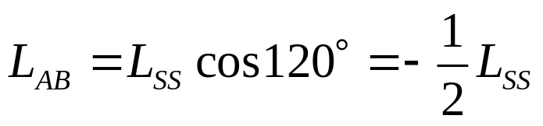
2. Voltage Balance Equation in 3-phase system
The voltage equation for the stator phase A can be written as:
where: resistance in one stator phase
self-inductance in phase A
Assume:

Slide 25
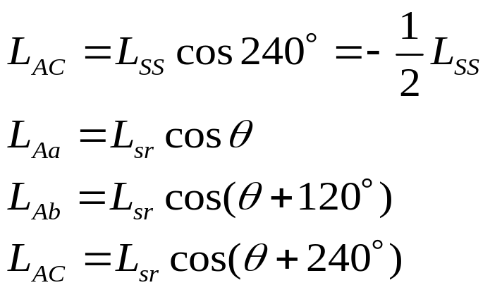
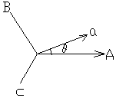
And
Similarly, the voltage equations including other phases on stator and rotor can be in matrix form as:

Slide 26
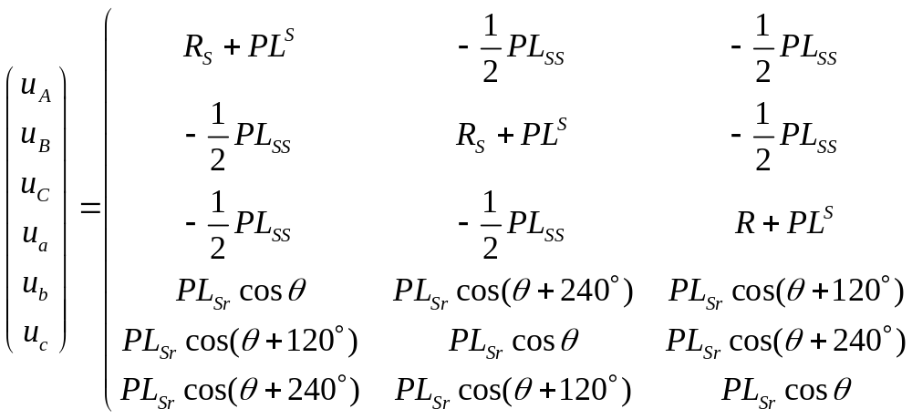
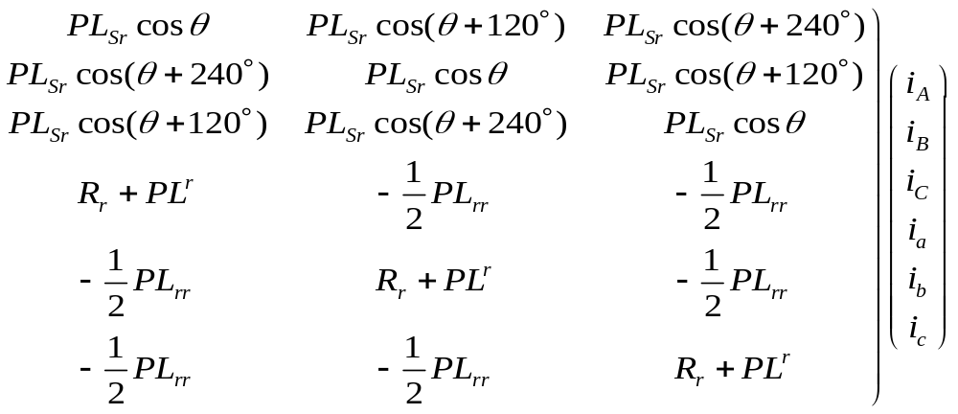

Slide 27
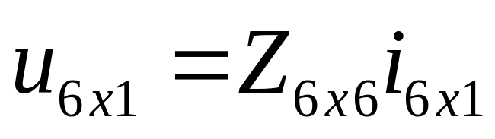
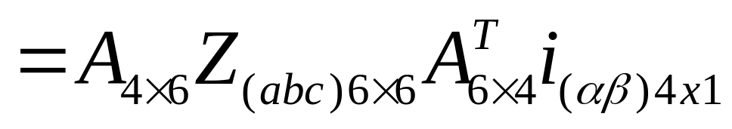
And in the matrix form as:
3. Voltage Balance Equations in two-phase system ( the vectors in zero axes are taken off)

Slide 28
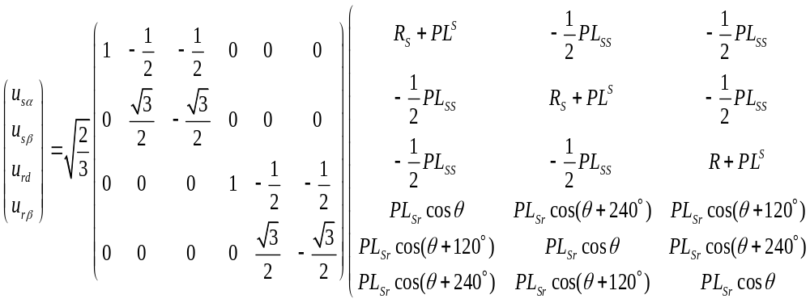
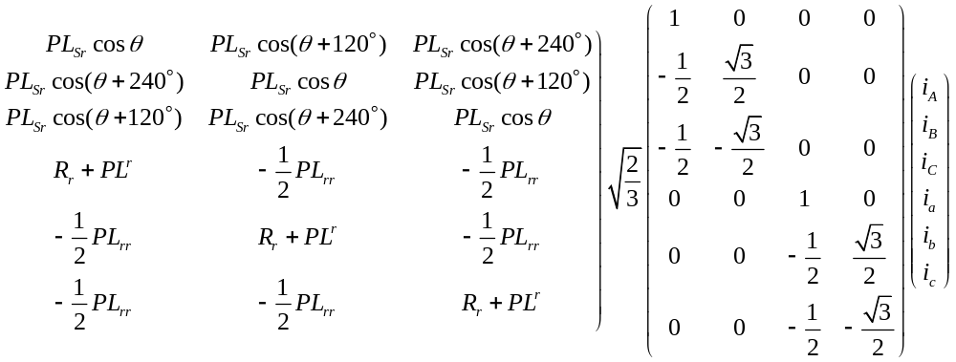

Slide 29
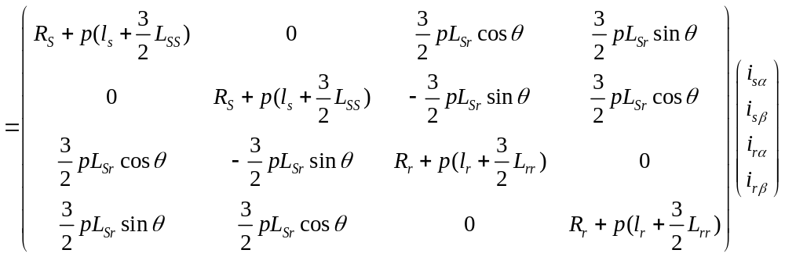
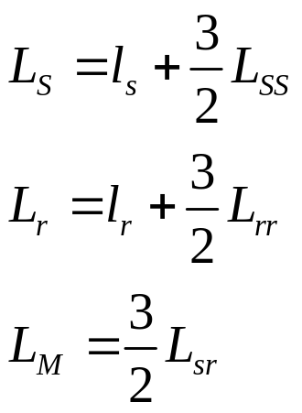
Assume

Slide 30
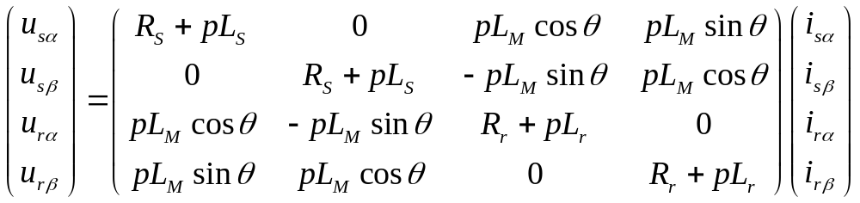
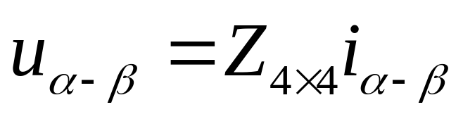
Then
Or:

Slide 31
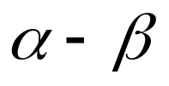
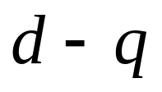
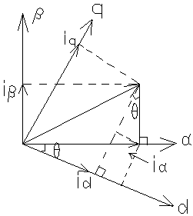
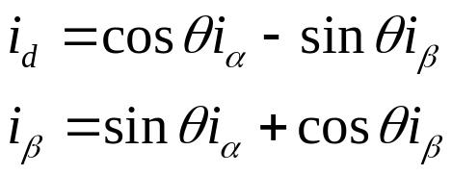
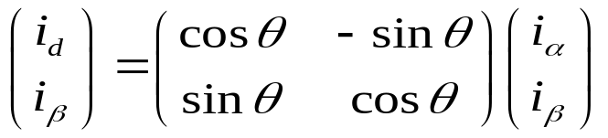
8.3.2 Transformations from to axes
Assume:
and
axes are as shown at right, then the equivalent currents
And in the matrix form:

Slide 32
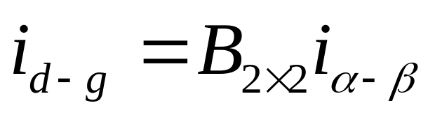
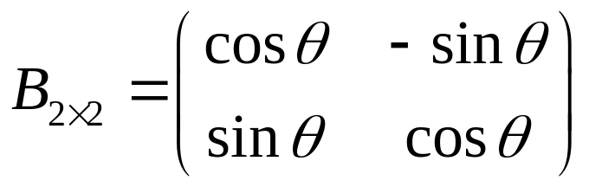
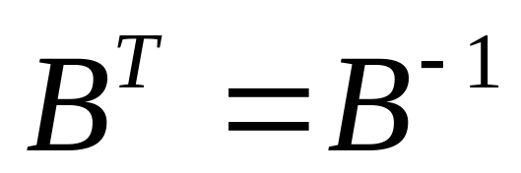
or
where
This is a very special matrix with the feature of

Slide 33
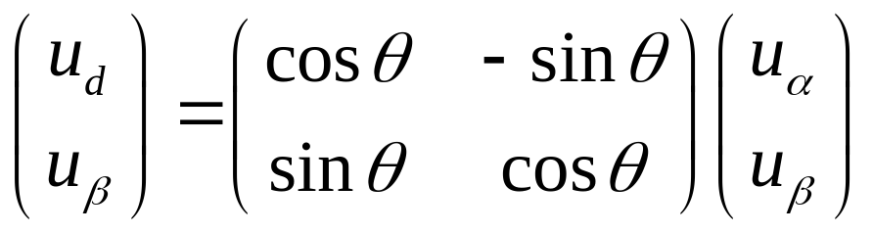
8.3.3 Voltage Balance Equations
the voltage transformation should be as same as current transformation:
Therefore, considering stator and rotor together,
we have:

Slide 34
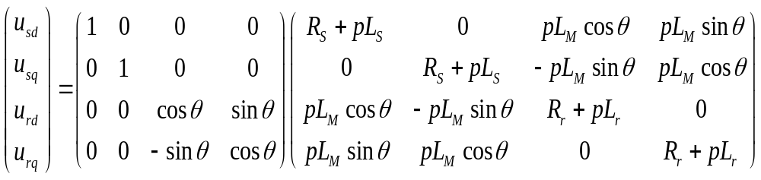
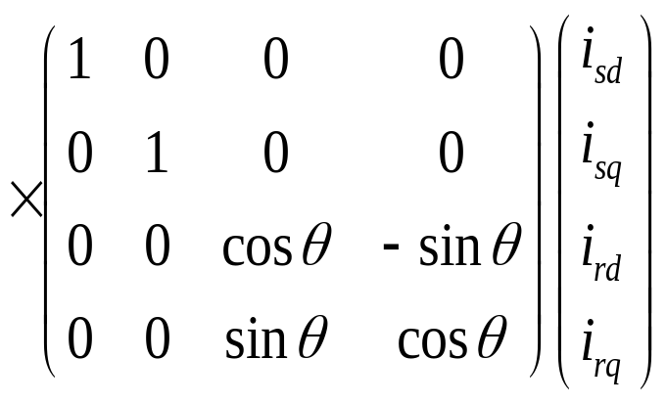

Slide 35
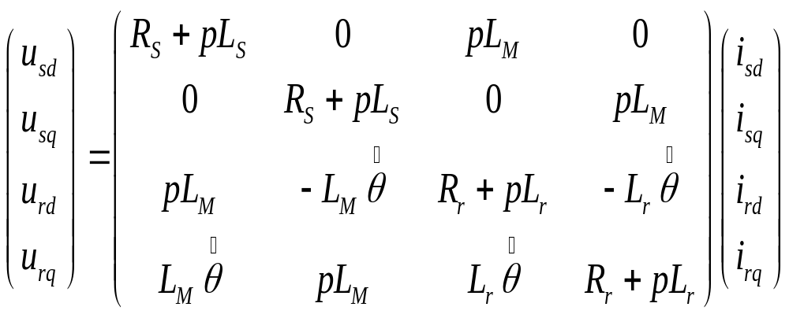

Slide 36
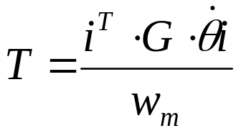
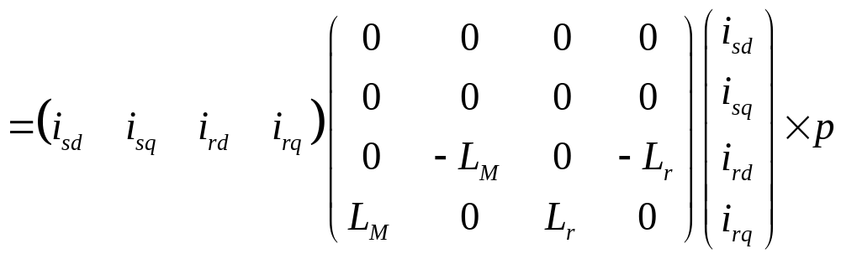
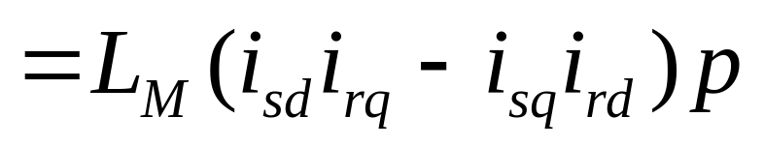
8.3.4 Torque Expression

Slide 37


Self induction and mutual induction of Primitive Machine
Every coil has its self induction
Every two coils in the same axis have mutual induction
No induction exits between two crossing coils so induction matrix can be expressed as:

Slide 38






Assume the real rotor flux linkage is in line with
then
and it should be noted that for an induction machine, the rotor windings are shorted so the rotor voltages of and should be zero. Therefore, we have:

Slide 39


Substitute eq.(8.32) into eq.(8.30), the torque is:

Slide 40


We can see that the torque equation is similar with the torque expression of a dc machine. So the question is: if we can find a way to control and separately, the machine performance should be as same as a dc machine, which is the basic idea of the vector control of ac machine.

